Slide 1
Exposure propensity score (EPS)
A score between 0 and 1 that reflects the probability of exposure given measured covariates
Notes:
This is sometimes proposed as a “virtual randomization” in which comparable patients are divided between treated and untreated. However, because EPS are conditional on measured covariates only, there is concern that they cannot control for unmeasured or imperfectly measured variables. Residual confounding bias therefore cannot be excluded
Propensity score analysis was first proposed by Rosenbaum and Rubin (1983) to infer cause and effect from studies in which experimental treatments cannot be randomly assigned to subjects. In epidemiologic research, a propensity score is an estimate of the probability that a subject would have received a ‘treatment’ (e.g., exposure to second-hand smoke), given information about his or her background. When two subjects have the same background but differ in their levels of exposure, they may be considered to have been randomly assigned to a treatment group (exposed) or control group (not exposed). Early applications tended to focus on biomedical and epidemiological issues, but applications are presently common in many disciplines.

Slide 2
Calculating exposure propensity scores
A binary treatment T, an outcome Y, and background variables X.
The propensity score is the conditional probability of treatment given background variables
P (T=1 | X = x)
Run a regression that has the probability of getting treatment on the left side, and the covariates that decide the treatment on the right side
I^{treat} = β₁ X₁ + β₂ X₂ +… β_{n} X_{n}
Notes:
You start with a simple specification (e.g. just linear terms). Then you follow the following algorithm to decide whether this specification is good enough:
Sort data by the propensity score and divide it into bins (buckets) of observations with similar propensity sores.
Within each bin, test (using a t-test), whether the means of the covariates are equal in the treatment and control group. (this is called checking the “balance”)
If a particular block has one or more unbalanced covariates, divide that block into finer blocks and re-evaluate
If a particular covariate is unbalanced for multiple blocks, modify the initial equation by including higher order terms and/or interactions with that covariate and start again.
In practice, this is a function in R.

Slide 3
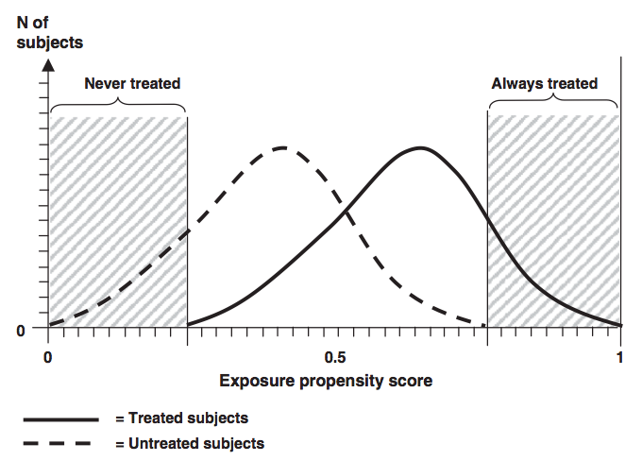
EPS distribution among treated and untreated subjects
Patients with low
probability of
treatment that
are never treated
Patients expected
to always receive
treatment
Notes:
The non-overlap of the exposure propensity score distribution among treated and untreated study subjects. In this example subjects with very low propensity scores are never treated, whereas subjects with very high propensity scores are all treated
Patients with low probability of treatment that are never treated – possible important contra-indication
In the extreme groups (NEVER treated and ALWAYS treated) there is little information about the outcome/exposure of interest
It is therefore questionable whether these patients should be included in an analysis. If they are, one should keep in mind the implicit distributional assumptions that regression models make to extrapolate data into a parameter space that is not supported by adequate data

Slide 4
Using exposure propensity scores
Matching individuals across the two groups studied
Conceptually easy to understand
Stratification
If you have enough data
Use as a feature in logistic regression
Straightforward to implement
Notes:
Matching based on co-morbidities and co-prescriptions tends to perform very well is adjusting for confounding across the treatment and control groups.

Slide 5
Effect of matching by EPS

Slide 6
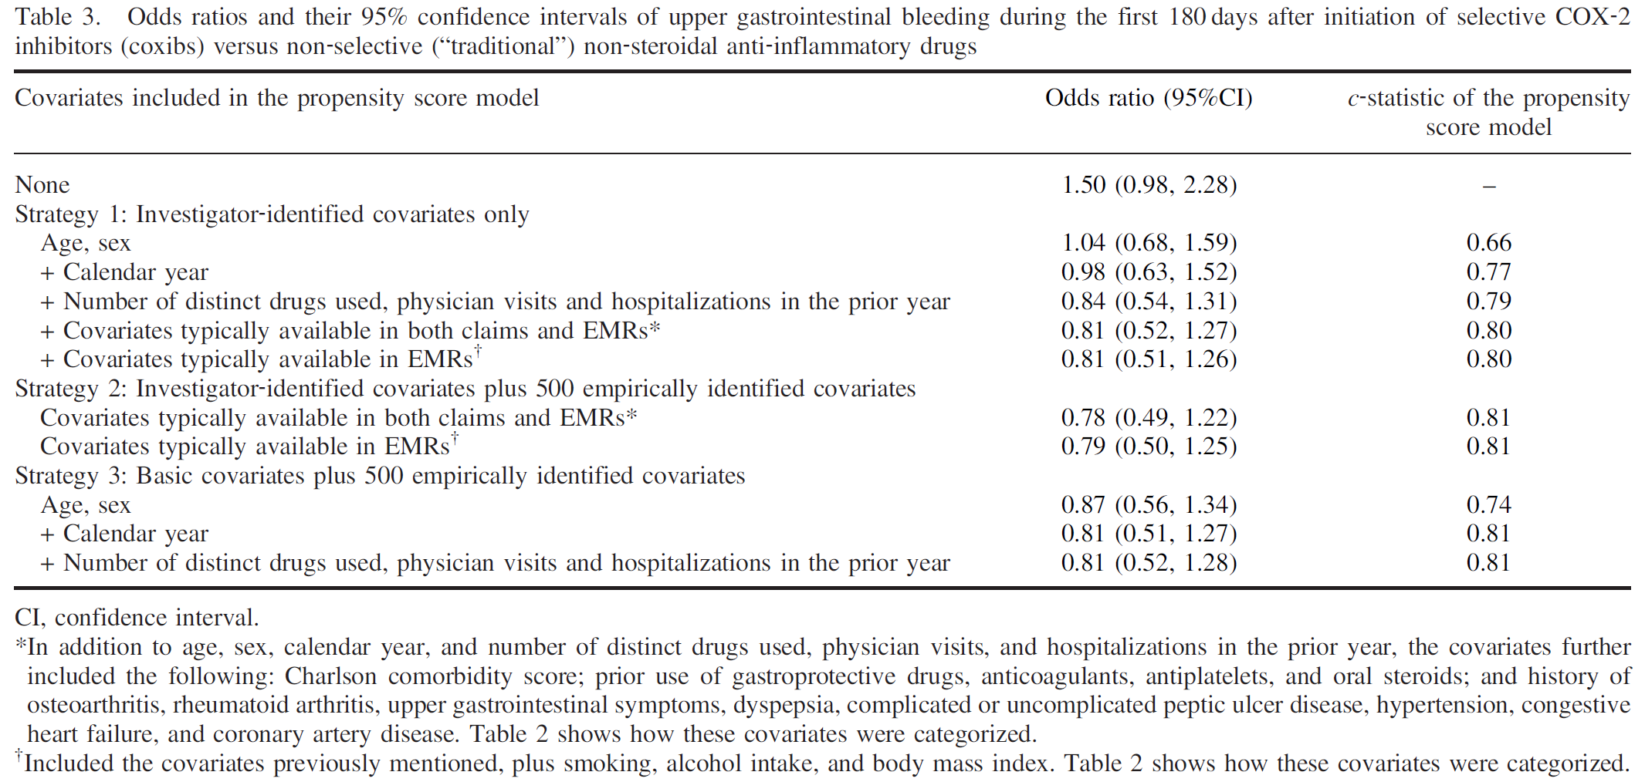
Toh et al
Notes:
The hd‐PS algorithm can be implemented in pharmacoepidemiologic studies that use primary care EMR databases such as The Health Improvement Network.
For the NSAID–UGIB association for which major confounders are well known, further adjustment for covariates selected by the algorithm had little impact on the effect estimate.

Slide 7
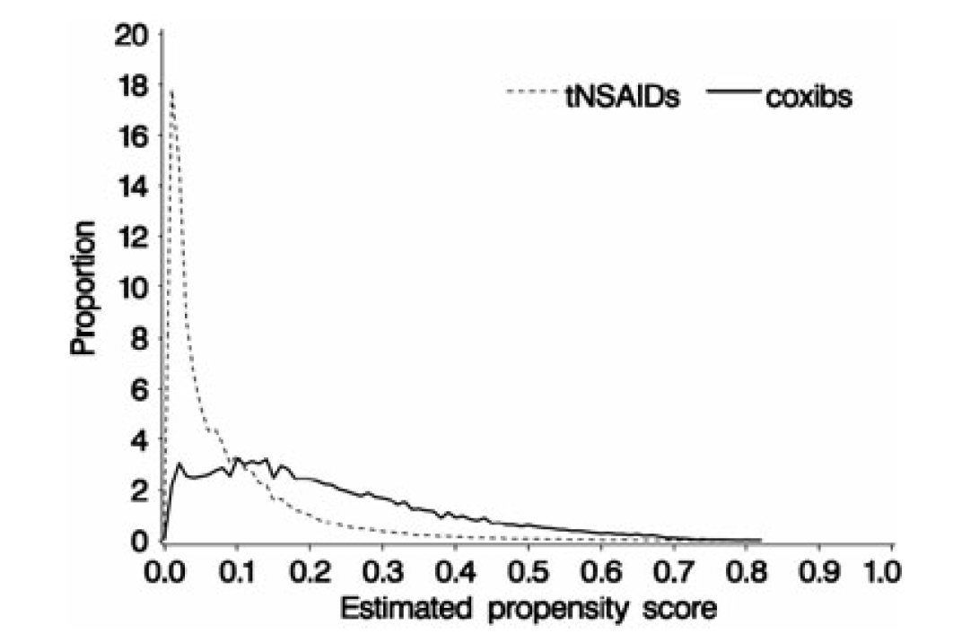
Notes:
This plot is the pre-matching EPS distribution in the Toh et al paper (previous slide).

Slide 8
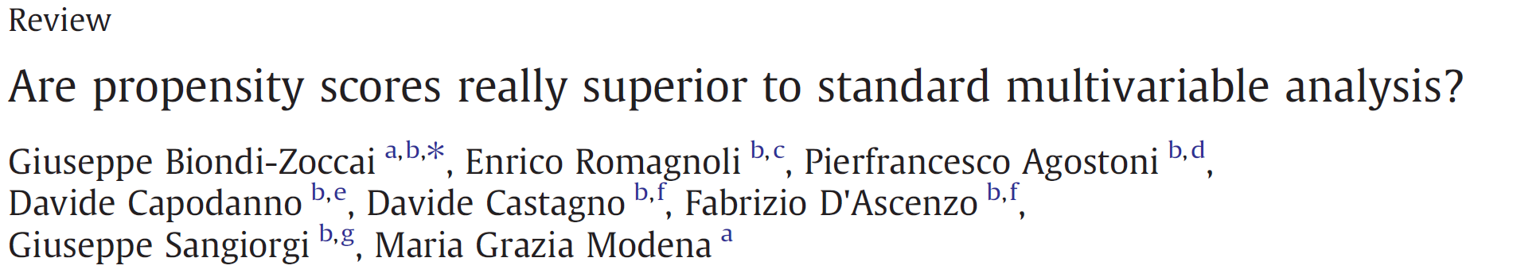
Do propensity scores work?
Propensity scores proved less biased, more robust, and more precise than logistic regression when there were ≤7 events per confounder
Logistic regression is the first choice approach when there are ≥8 events per confounder.
Notes:
Authors found that propensity scores are a good multivariable technique when there are ≤7 events per confounder, but with a suboptimal (35%–60%) empirical power.

Slide 9
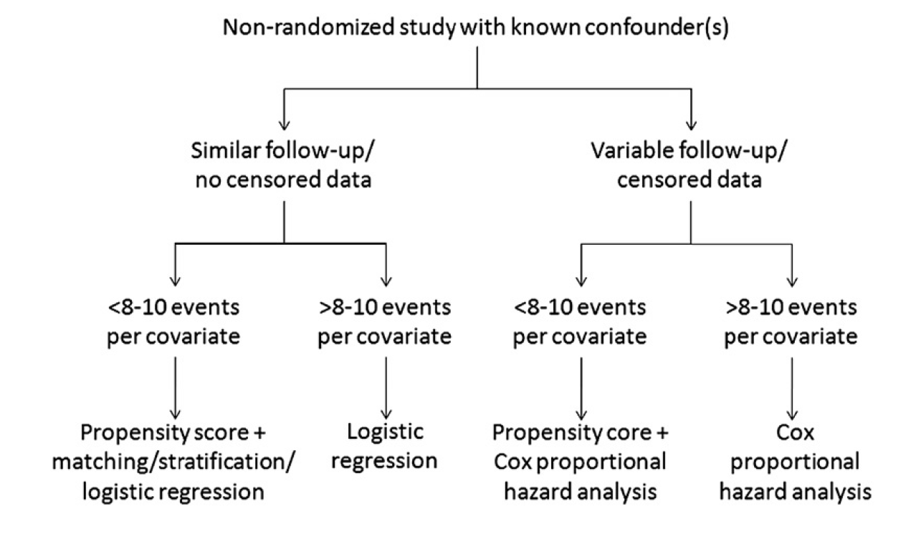
Notes:
Our final recommendation is thus that, whatever method you employ, careful analysis and reporting are mandatory to enable appropriate appraisal of the reported findings and, whenever necessary, suitable replication.
The bottom line is also that propensity score methods are not meaningfully superior to standard multivariable approaches when adequate assumptions for logistic regression and Cox proportional hazard analysis are met and, in particular, when the event per variable ratio is N8–10

